Slide 1

THE LARGEST ONLINE BOOK STORE PAKISTAN.
Project Picture
Notes:
Please keep the title brief and specific. You may place relevant graphics/images on the slide; a project picture would be preferred.

Slide 2
One Sentence Pitch
Our team is developing a website to help Pakistani Authors promoting themselves at a higher platform however there is no such website which only publish and promote Pakistani books.
(Please be specific and focused; see notes below for help.)
Notes:
My organization, (name of company)
is developing (a defined offering) [be specific, avoid buzzword e.g. “a website”, “a mobile application”, “hardware”]
to help (target audience) [identify demographics e.g. “women age between 25 to 35 years”, “system administrators at small technology businesses”]
(solve a problem) [specify your market e.g. “reduce the time collecting bill payments”]
(with secret sauce) [clarify the buyer e.g. "by sending automated email alerts based on analysis of highest response times"]
Ref: https://fi.co/madlibs

Slide 3
Introduction
COMPANY LOGO
ORGANIZATION
Name
MISSION
Our mission is to dispense a platform for Pakistani authors to promote their published books.
PROJECT DIRECTOR
Text
BUDGET
PKR 836,000
CORE TECHNOLOGY
Please see notes below.
OBJECTIVES
The core objective is to facilitate users to purchase books online which help improve their reading convention and allow authors to promote their published books.
Notes:
Brief introduction of your company. Mission and objectives must be short and focused towards proposed project only.
CORE TECHNOLOGIES:
3D/4D Printing Augmented Reality / Virtual Reality Big Data Artificial Intelligence
Cloud Blockchain Robotics Neurotech
The Internet of Things Shared economy CleanTech Wearables, Implantables
Driverless Vehicles, Drones Programmable Hardware Synthetic Biology Quantum Computing/Supercomputers

Slide 4
The Problem
There seems to be many websites named as online book stores for Pakistan, but no website promotes our Pakistani authors neither any website is properly developed with all the feature and utilities that can build up a reader interest or a platform where authors can sell their books and readers can specifically buy from. However many websites exist that claims to be Pakistan largest online book stores but does not seems to fulfill the claim. Those website contains scattered data there don’t even exist proper profiles of authors and specifically the books published by those authors. A reader will always search for the best and ease of access to his desired data.
Notes:
Problem(s) exists in current market. What is the problem you are trying to solve? Be Specific. Infographics may be added.
Support with numbers. Regulatory issues may be included.

Slide 5
Problem Cont.. References of other websites
Amazon website https://www.amazon.com/
International online bookstore site https://www.betterworldbooks.com/
Pakistan Online books Marketplace https://www.kitabain.com/

Slide 6
The Solution to the Problem
We are willing to develop a Pakistan Online Book Store which will only support and promote our Pakistani writers, help them to promote their books and provide them a platform to sell their books to targeted audience. Our website will provide all the features that can build up a reader interest also suggesting the books as per his/her interest.
Loving book readers can now browse multiple book sellers from one source and select required titles at comparative rates from their homes. Book sellers will also reach up to maximum users all around Pakistan through our Online Book Store. The core objective of the Online Book Store is to facilitate communities in Pakistan and provide accessibility of books in all parts of Pakistan so that reading habit can be improved.
Notes:
What is your solution to the problem? Emphasize on the solution your startup will be providing to address the problem. A relevant image/graphic describing the product would be preferred.

Slide 7
The Solution to the Problem
A reader can:
Login
Purchase a book
Download a book
Check and submit the review
rating the Author
Suggest books to anyone
Share books online
Can add to cart to buy later.
Gift a book
Review friends recommendations
User can search book using book title, isbn

Slide 8
Features we provide
Reading book Online
Magnifier
Slide View
Narrator
Editing Pen (free hand writing)
Suggestion of other Books with help reader interest.
Categorization of books like (Adults, Children )
Add or Remove Comments
Comparison of text
Cost Comparison of books listed on other websites
Formatting of the text(highlight, bold, underline)
Dictionary
Set the status to read, currently-reading, to read
activity log ( till where the reader have read the book)
Continue form where he/she left
Online Payment via ( Debit/Credit card, easy paisa, jazz cash)

Slide 9
Comparison Matrix
Best Options
Amazon website
BooksIn
Pakistan bookstoreMarketplace
THE LARGEST ONLINE BOOK STORE PAKISTAN
Reading book Online | Yes | No | Yes | Yes
Comparison of text | No | No | No | Yes
Formatting of the text(highlight, bold, underline) | No | No | No | Yes
Dictionary | Yes | No | Yes | Yes
Set the status to read, currently-reading, to read | No | No | No | Yes
Date of reading started to finish date | No | No | No | No
activity log ( till where the reader have read the book) | No | No | No | Yes
Continue form where he/she left | No | No | No | Yes
Translation of books | Yes | No | No | No
Free two day shipping | Yes | Yes | No | Yes
Audio books online | No | No | No | Yes
Notes:
Please provide a comparison matrix (including cost) of key available products and proposed solution.

Slide 10
Market / Opportunity
Market Forecast
Geography
Based on location, we are targeting all 5 provinces of Pakistan which includes the total population of 204.73million.
Demography
We include every income class and age group who are fond of reading books.
Behavioral
The estimated number of users for which we are sure that we will attract them to visit our website through successful marketing and advertising will be 50m. This number will increase through more advertising.
Notes:
Please describe the target market, explain possibilities of the total market size, and volume of market share. Infographics may be added.
TARGET MARKETS:
Automotive, Aviation, Marine Business, Marketing, Finance Defence, Security, Safety
Education & Training Environment, Water Management Entertainment, Tourism, Sport/Recreation
Food, Livestock, Agribusiness Healthcare Infrastructure, Housing & Transport
Mining Equipment Technology & Services Oil, Gas, Energy Textiles, Clothing, Footwear

Slide 11
Go to Market Strategy
Users who want to read novels, religious books, biographies, autobiographies, fantasies, life stories, science fiction, self-help guides, and more today as per their interest, so we solely offer a platform where users can purchase, review, and read books that have been published by Pakistani authors.
There will be categorization of books for users (adults, children, and academic) to give easy accessibility.
For our customers we will promote our website through social media, blog, SMS marketing, email marketing, and search engine optimization.
Notes:
What is your advantage over the competition? Proprietary technology? Key partners/customers? Better distribution channel? Did you identified the customers? Did you contact customers and how many would be interested to get the product? Do you have partners to go in international market?

Slide 12
Why Us? Why Now?
There exist many websites of online book store but our website is divergent from other sites because no any site promotes our authors and we will promote our Pakistani author’s books where users can purchase their desired books and articles based on their curiosity all around Pakistan. We are likely to furnish a platform where we can promote and publish our books and Pakistani authors can exhibit themselves by providing their information including their published books. The main purpose of this website is to facilitate a platform which will improve reading skills among people of Pakistan and to provide comprehensibility of purchasing books.
Notes:
Explore the competition/trends in the market. How is your company different? What is your passion? Why are you doing this and others cannot? Highlight achievements.

Slide 13
Product Cost Matrix
Description | Amount per year
Marketing and promotion | 100000
Design of websites | 100000
Development of website | 300000
Hardware | 30000
Tools and software | 5000
Domain purchase | 7000
Support and maintenance | 40000
Quality assurance | 5000
Indirect costs | 9000
Enhanced websites | 30000
Salaries and wages | 200000
Others | 10000
Total (Retail Cost): | 836,000
Notes:
Calculate the product retail cost using above breakup. Product retail/selling price may include R&D cost, raw material, assembly, manufacturing overheads, distribution overheads, sales overheads, marketing, general admin expenses, quality assurance, certifications, support and maintenance, profit margins etc.
You may change the cost heads as deemed necessary.

Slide 14
Financial Strategy
REVENUE MODEL
the major chunk of revenue will be collected from following categories,
All categories of books including all languages spoken in Pakistan (Sindhi, Balochi, Urdu, Pashto etc).
Magazines which can be sub-categorized in family, children, college, fashion, consumer, trade & business. Side categories: weekly, monthly, quarterly, every six months, yearly.
Used books
Donate a book by courier or uploaded
Membership- 7 day free trial and then it will be charged.
Notes:
Explain how the business will make money i.e., market share, pricing, revenue model. Infographics may be added.
2 years’ projections to be shown here.
Must show acquisition of next round of funding.

Slide 15
CASH FLOW PROJECTIONS
Cash Inflows
Cash will be generated through
-online payment system where user will download the preferred book.
-order of book.
-reading the online book.
-ads promotion.
-other events promotion.
-subscription payment.
-delivery at Rs.20 margin.
Cash Outflows
-Marketing and promotion
-telephone
-office supplies purchases
-bank charges
-employer cost
-internet account
-transaction cost

Slide 16
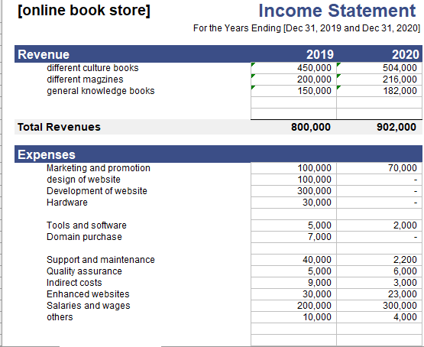
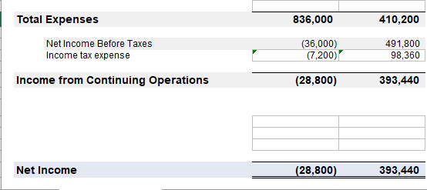
Revenue Model & cash flow projection

Slide 17
Cash inflow & outflow
Cash Inflow
Cash Outflow

Slide 18
Project Team
Board
Advisor
Member1(name,tittle,skill,exp)
Member2(name,title,skill,exp)
investor
Notes:
Detail of the management Team. An organogram may be preferred.

Slide 19
Thank You!

